Slide 1
Hajj Seminar
By
Sh. AbdelJalil Mezgouri

Slide 2
Agenda
Types of Al-Hajj
Pillars of Umrah & Al-Hajj
Wajibat of Al-Hajj
Sunan of Al-Hajj
Prohibitions of Ihram

Slide 3
Types of Al Hajj
Al Ifrad – Single Hajj
The person performing this type of Hajj is called Al Mufrid
Al Qiran – Combined Hajj
The person performing this type of Hajj is called Al Qarin
Al Tamattu – Interrupted Hajj
The person performing this type of Hajj is called Al Mutamittu

Slide 4
The Pillars of Umrah & Al-Hajj
Umrah
Intention
Tawaf
Sae'e
A pillar is an act which MUST BE DONE, without it the Hajj is invalid.
Hajj
Intention
Being In Arafat
Tawaf Al Ifadah
Sae'e

Slide 5
Wajibat (Duties) of Al-Hajj
Al Ihram from the Miqat
Staying in Arafat till Maghrib on the day of 9th Dhul Hijjah
To spend the night in Muzdalifah on the 10th of Dhul Hijjah
Spending the nights of Tashreeq, 11th, 12th and 13th of Dhul Hijjah in Mina
Throwing Jamaraat
Shaving/Trimming of Hair
Tawaf Al-Wida’a
Note: If you miss a Wajib you need to slaughter a sheep for every wajib missed and distribute it in the Haram.

Slide 6
Sunan(Ettiquetes) of Al-Hajj
Ghusl(bath) at Ihram
White Clothes for Men
Talbiyah
Spending the night in Mina on the 9th of Dhul Hijjah
Kissing the black stone
Al-Iddibah – Showing the right shoulder for men in Tawaf Al Umrah.
Raml – to speed up the steps in the first 3 rounds of Tawaf Al Umrah.
Note: If you miss a Sunan, there is nothing on you.

Slide 7
Prohibitions of Al Ihram
Cutting\Shaving the hair
Nail Clipping
Covering the head (for men)
Clothes for men
Wearing perfume in Ihram
Hunting
Marriage
Spousal Relationship
- If a person does any of the above out of ignorance or forgetfulness, there is nothing on him\her.
- If any of these is done intentionally, the person must do one of three:
1. Fast 3 days
2. Sacrifice a sheep
3. Feed 6 poor people

Slide 8
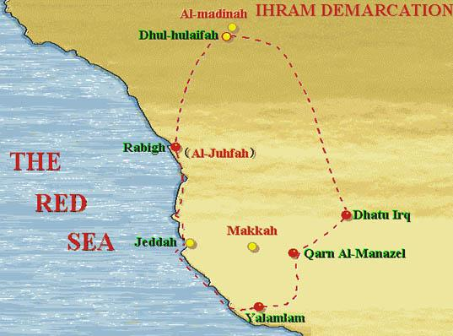
Miqat

Slide 9
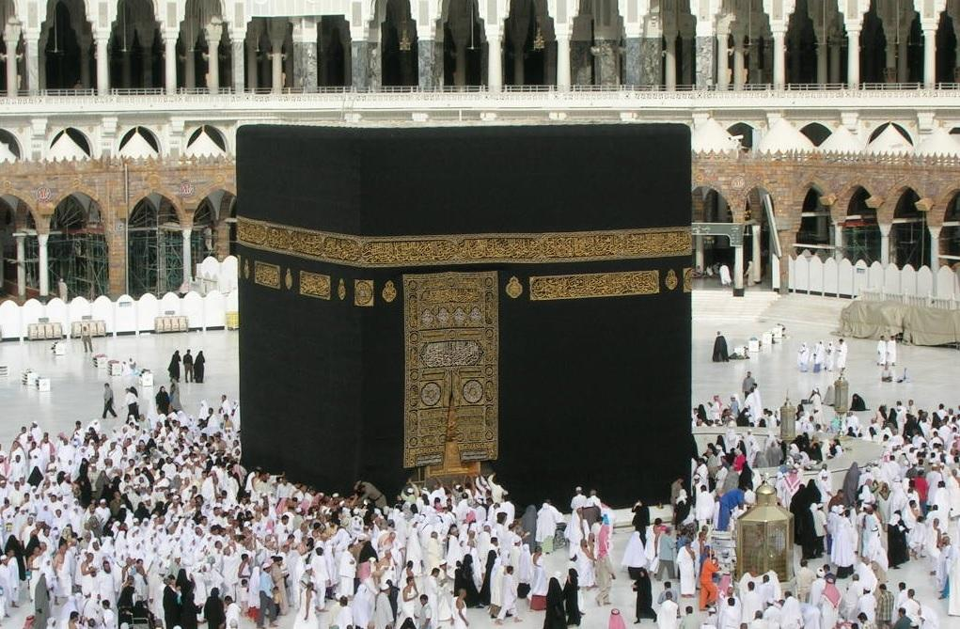
Al Ka’bah
Rukn Yemani
Hateem
Hajr Aswad
Maqaame
Ibraheem

Slide 10
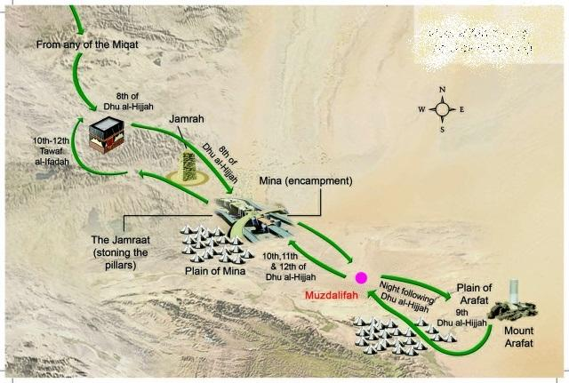
Mina-Arafat-Muzdalifah

Slide 11
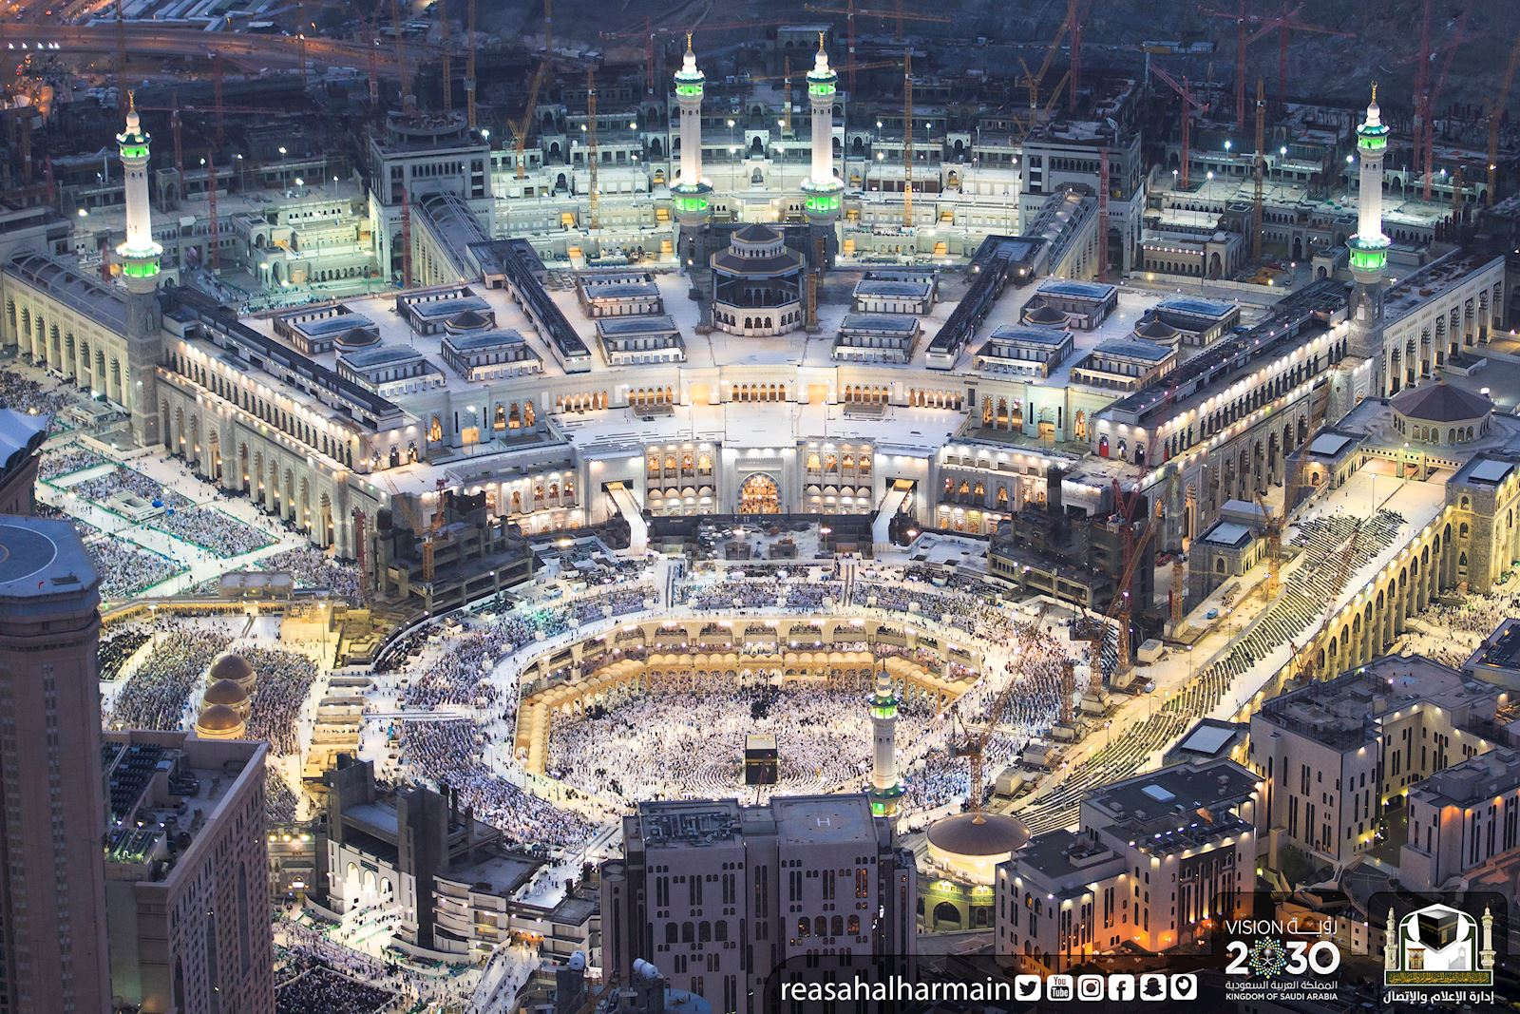

Slide 12
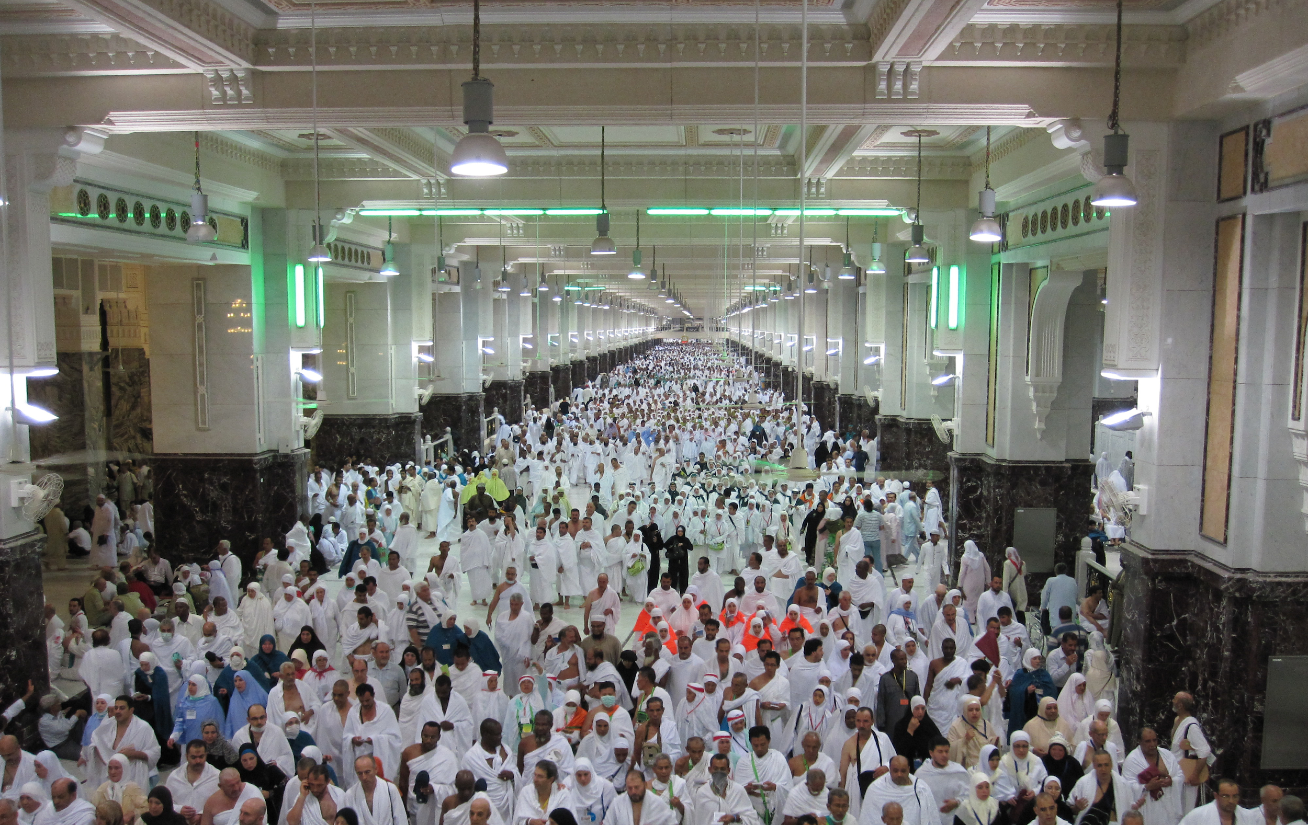

Slide 13
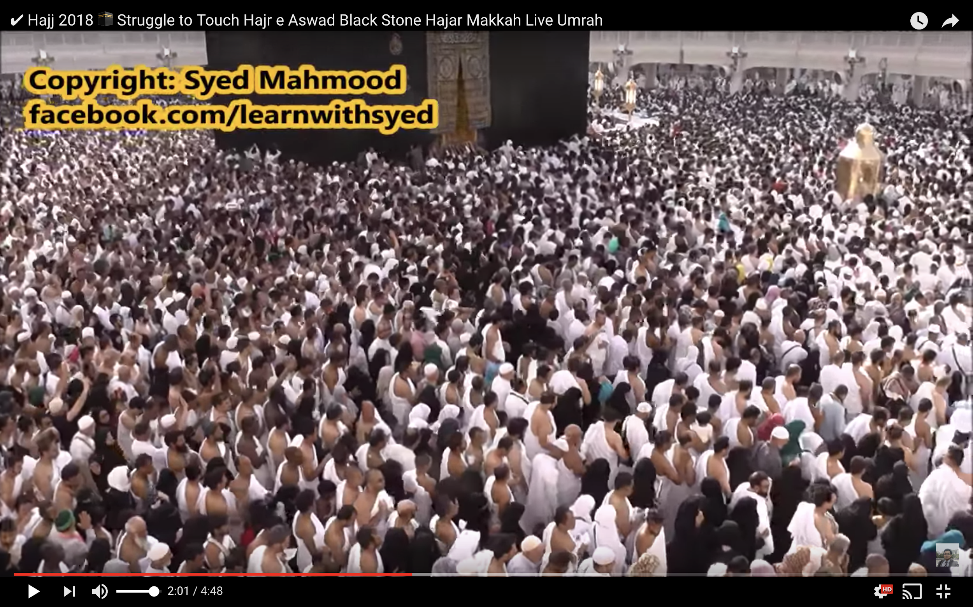

Slide 14
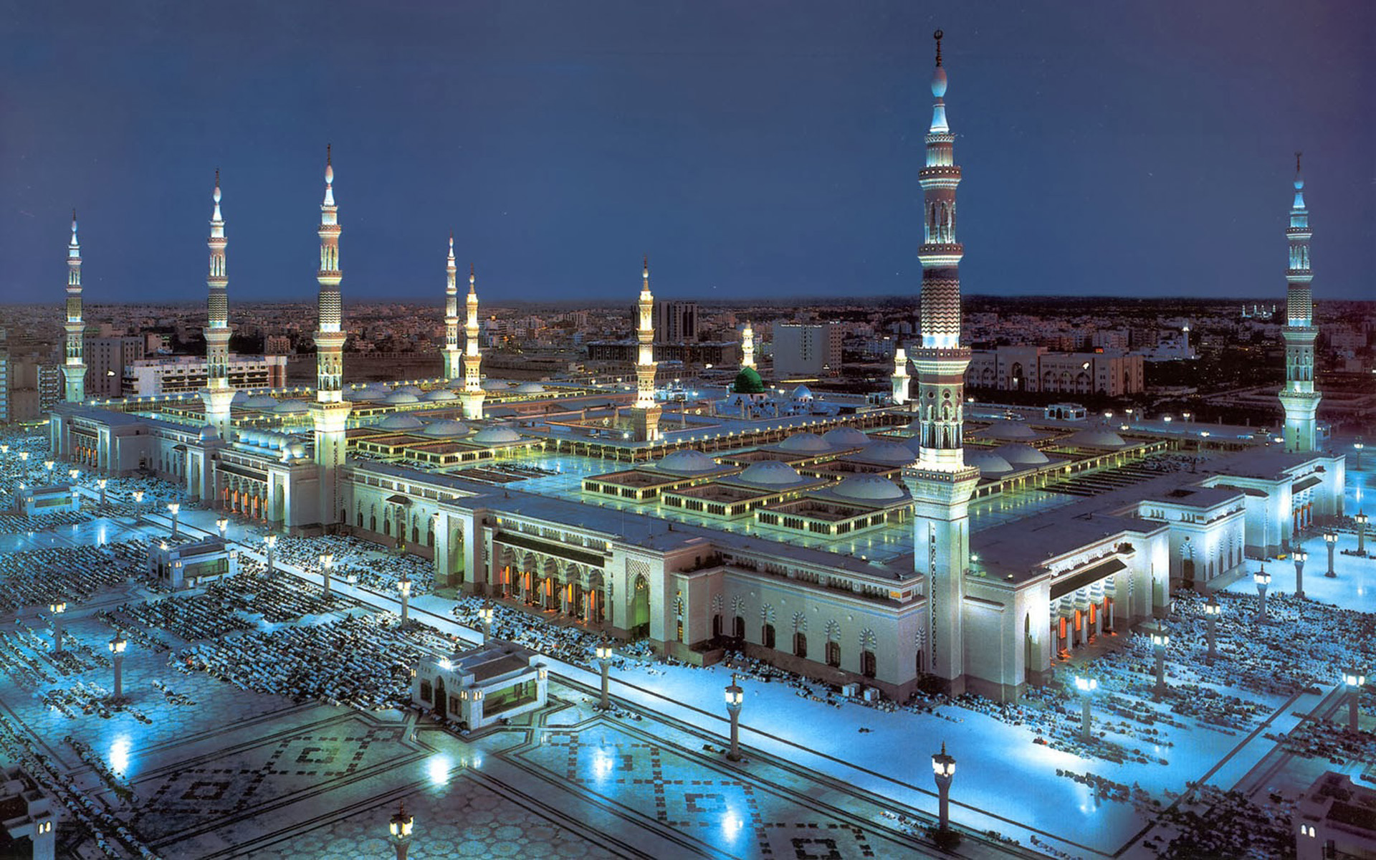

Slide 15
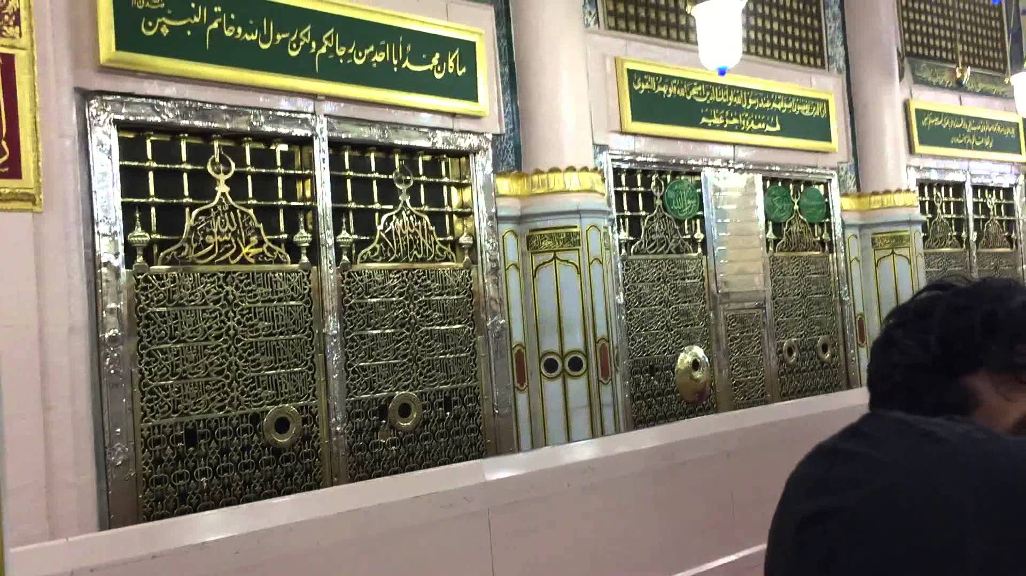

Slide 16
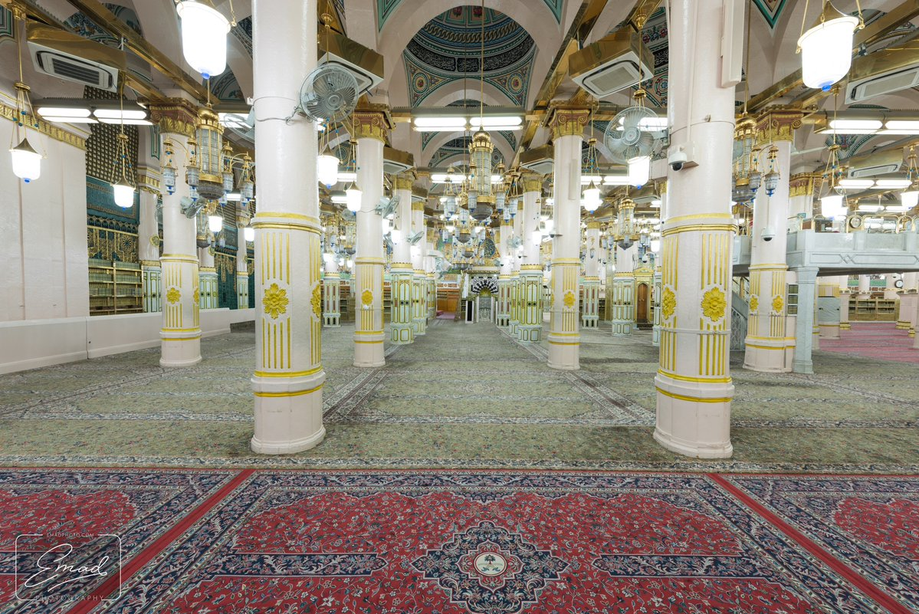

Slide 17
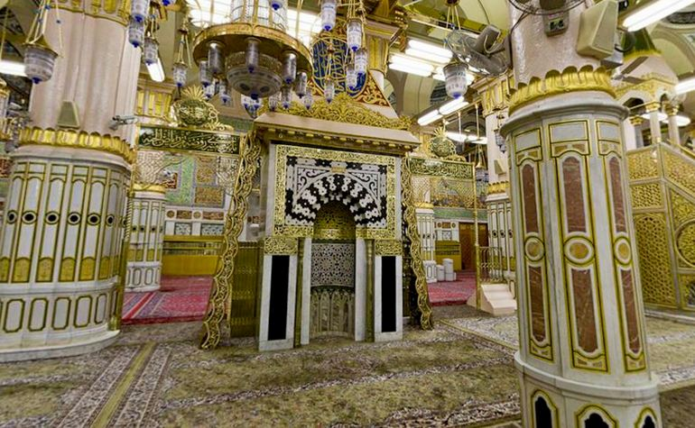

Slide 18
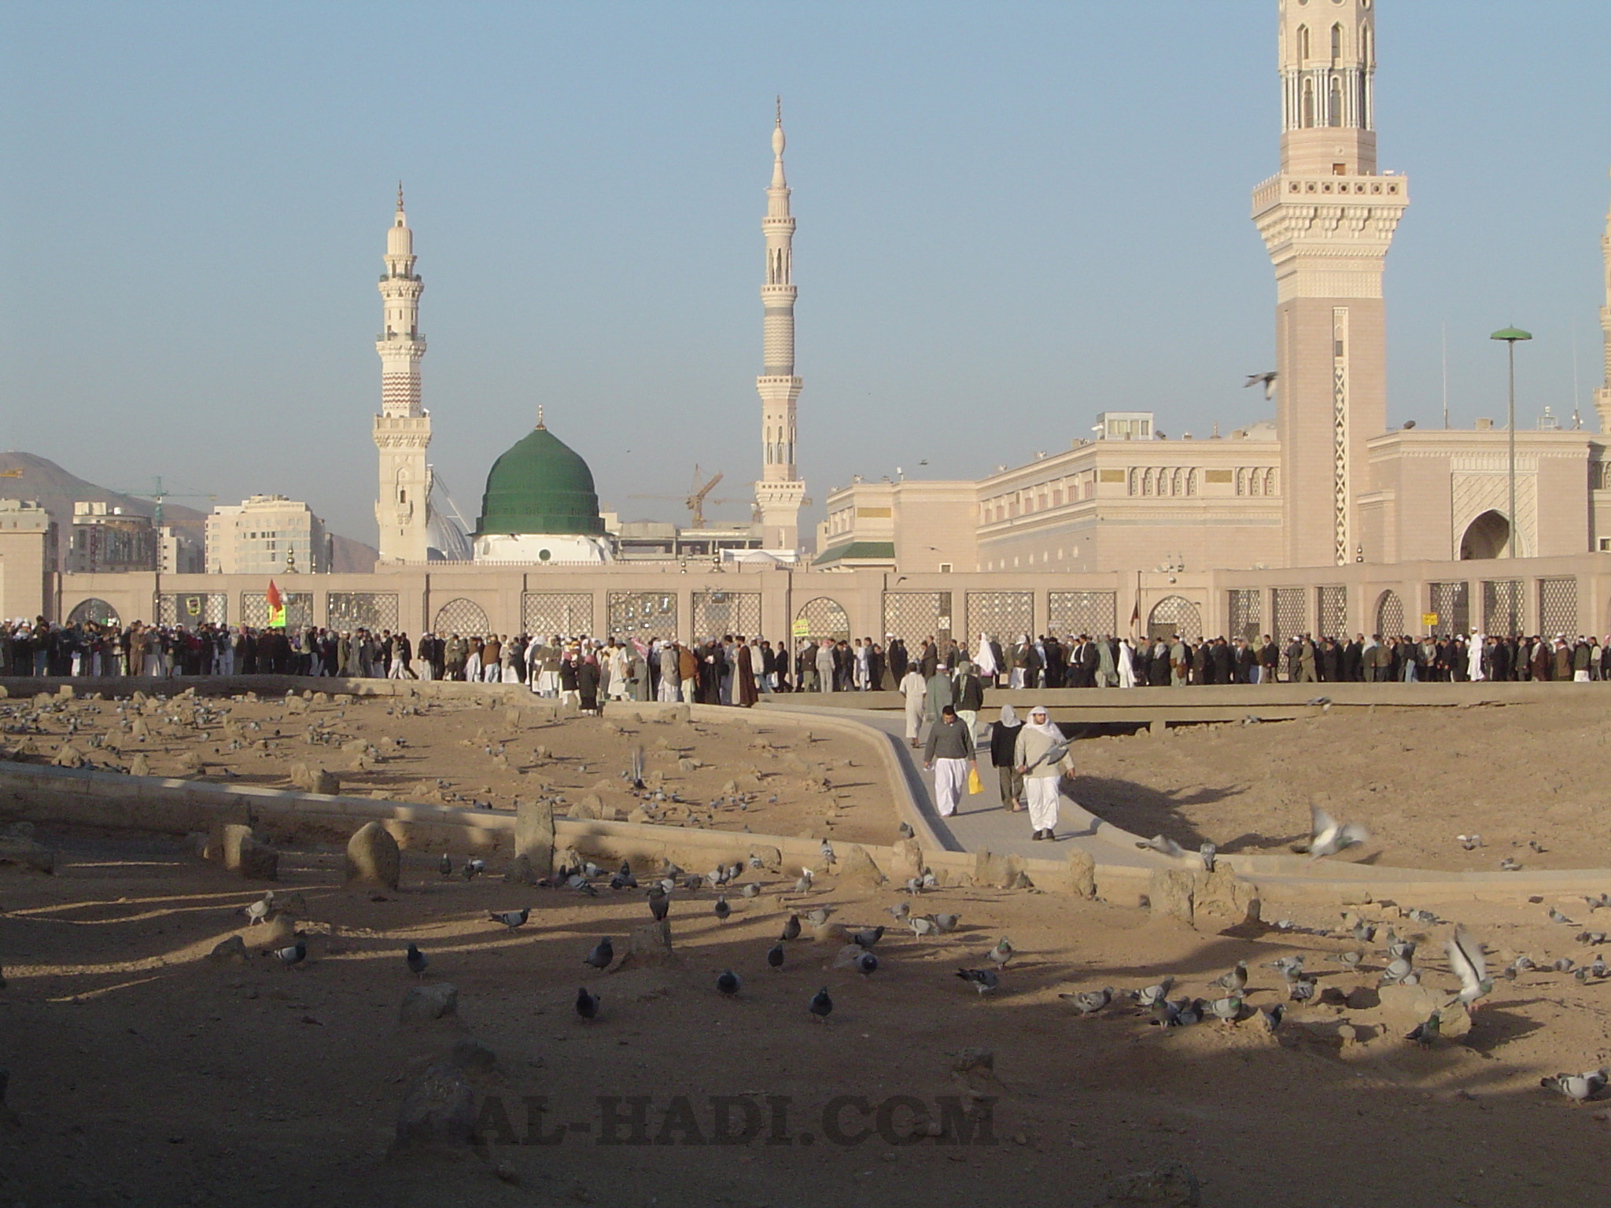

Slide 19
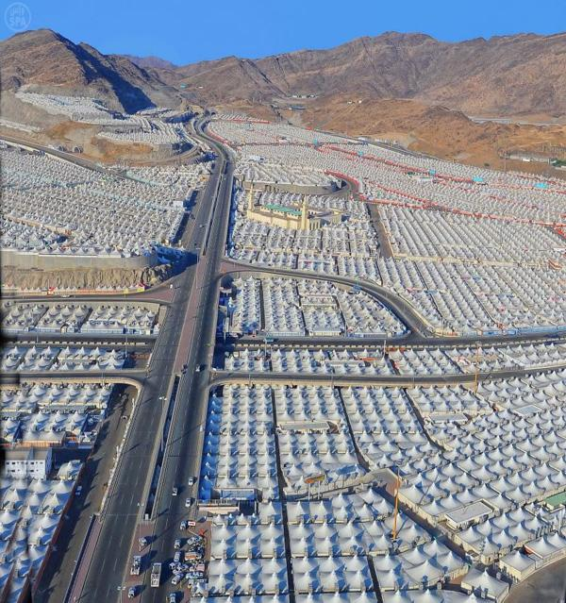
Mina

Slide 20
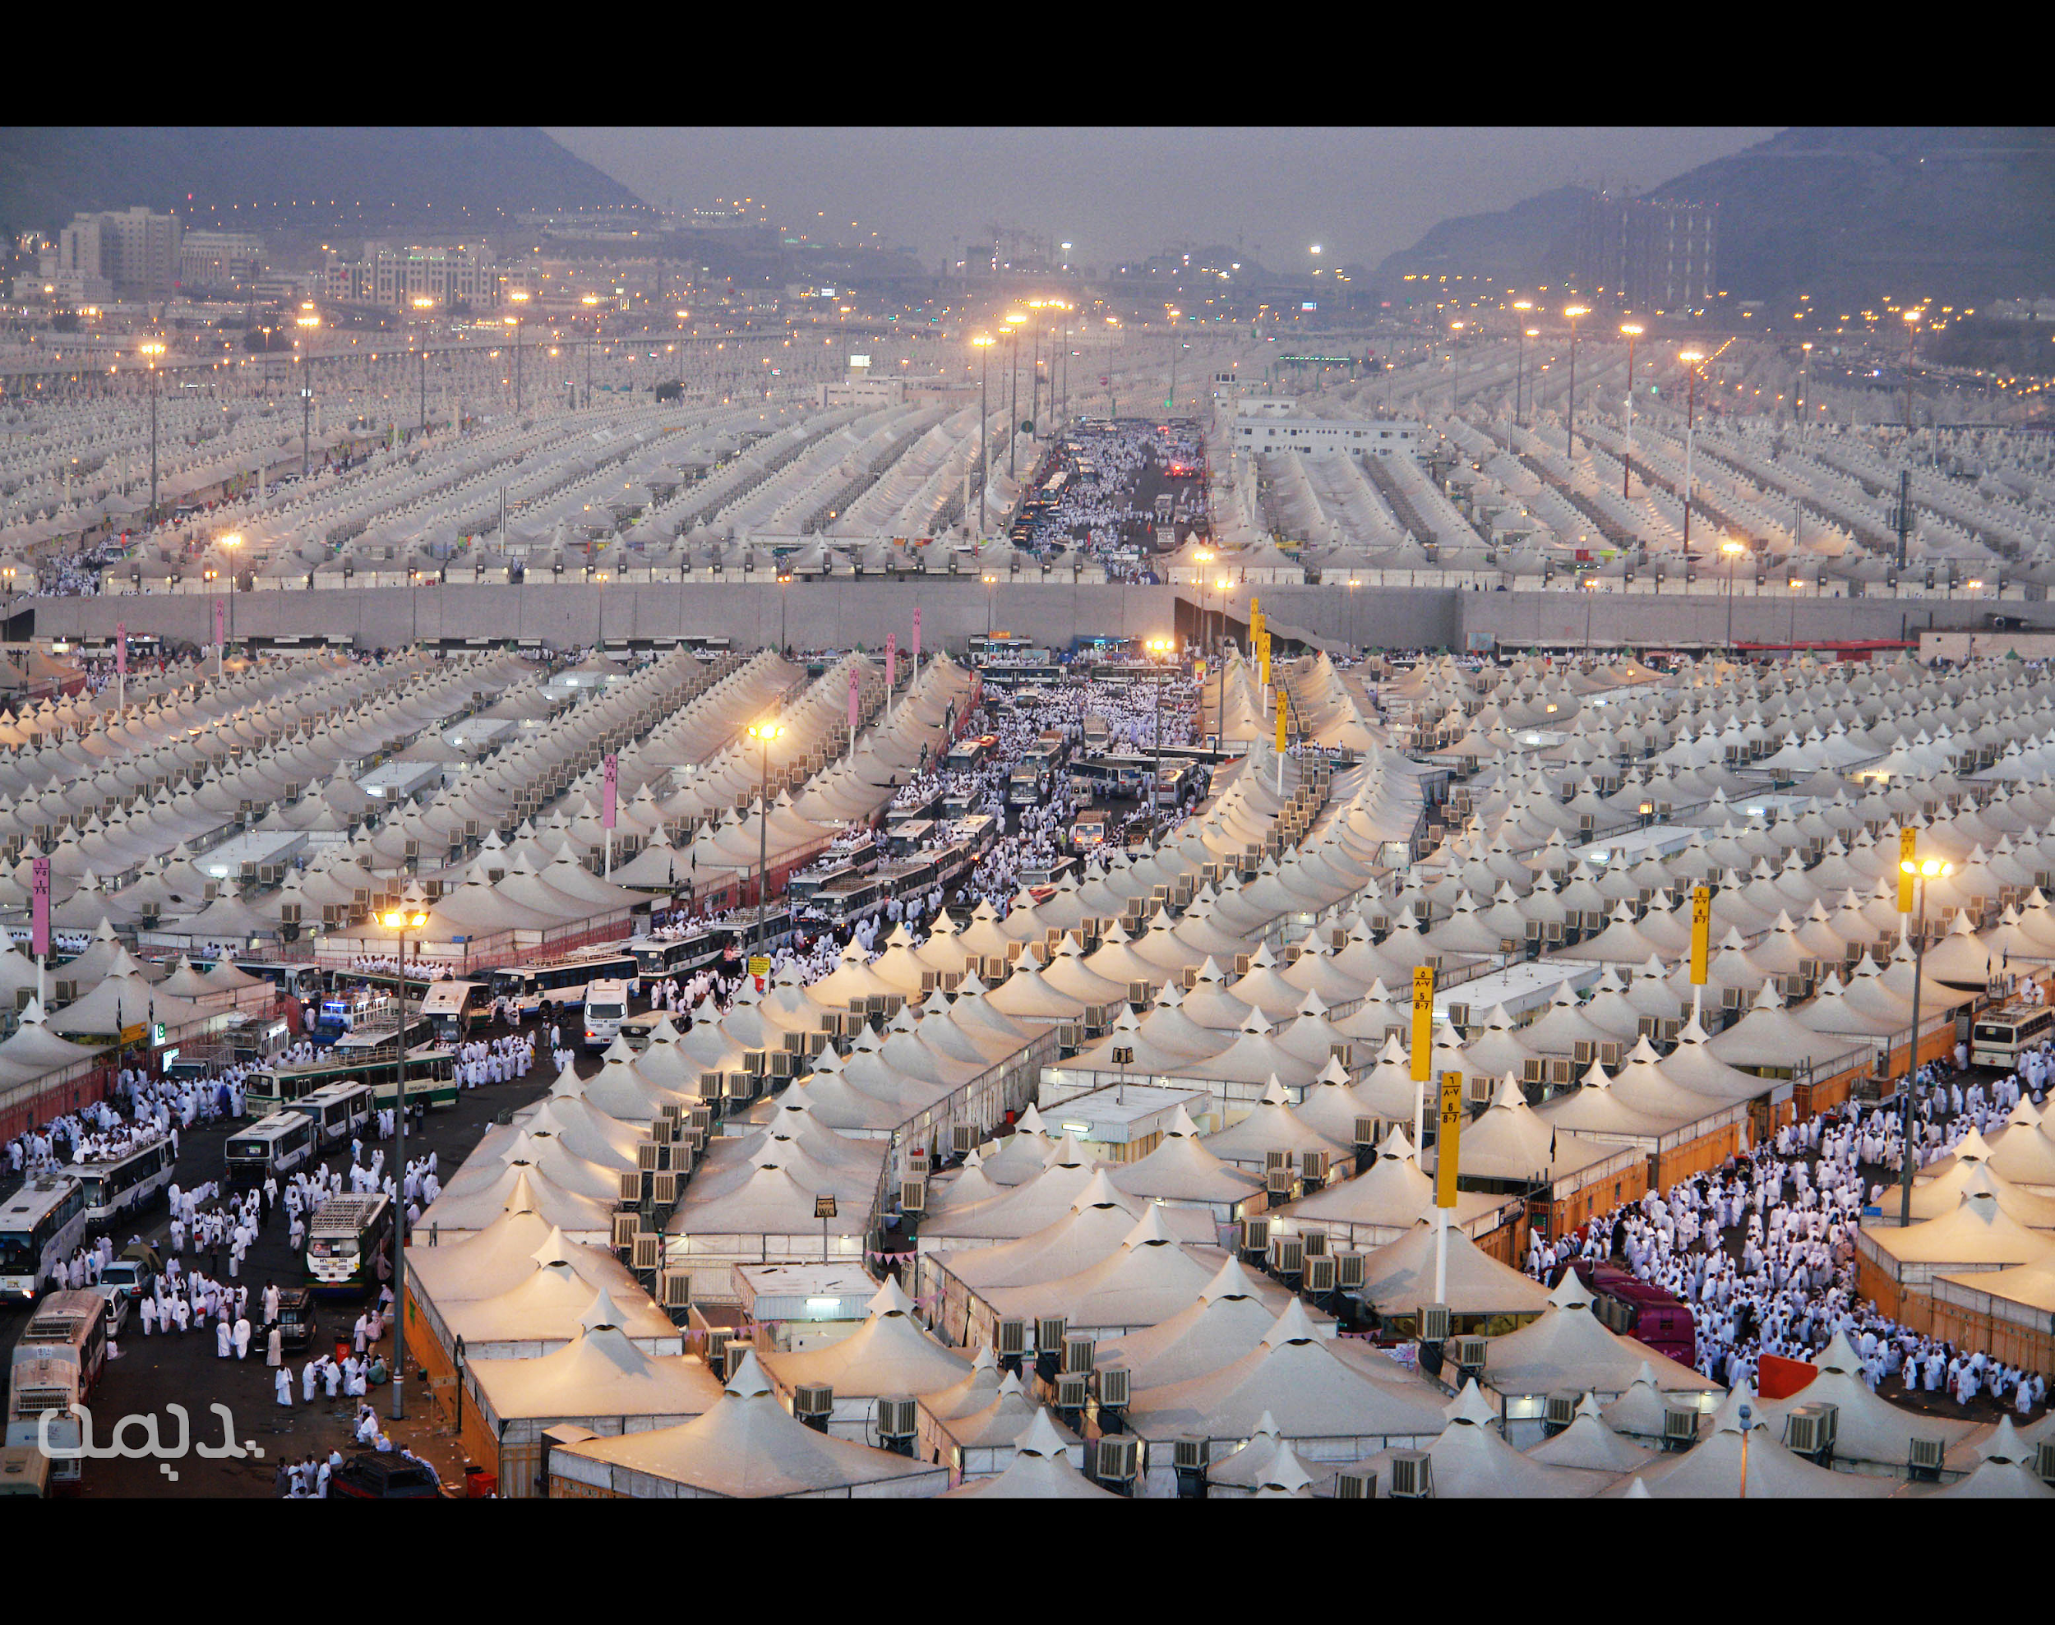

Slide 21
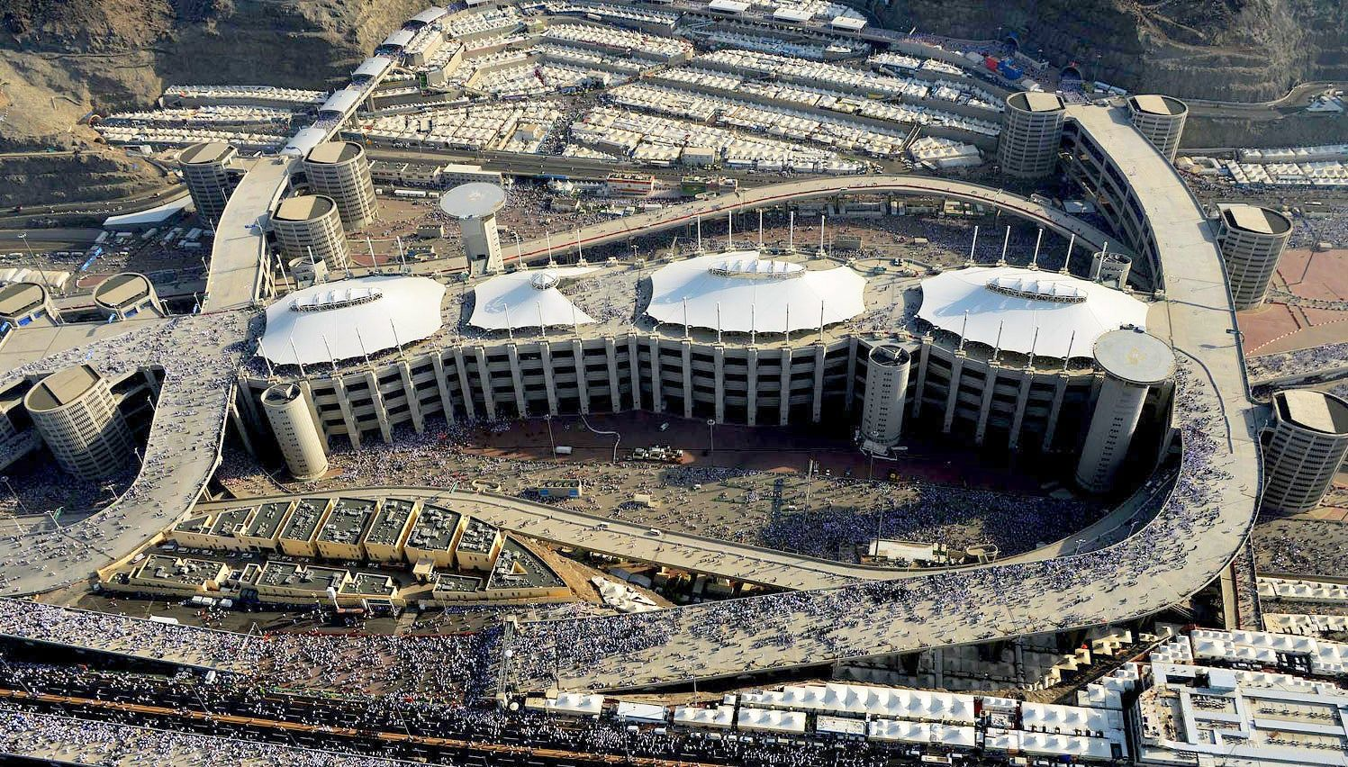
Jamarah

Slide 22
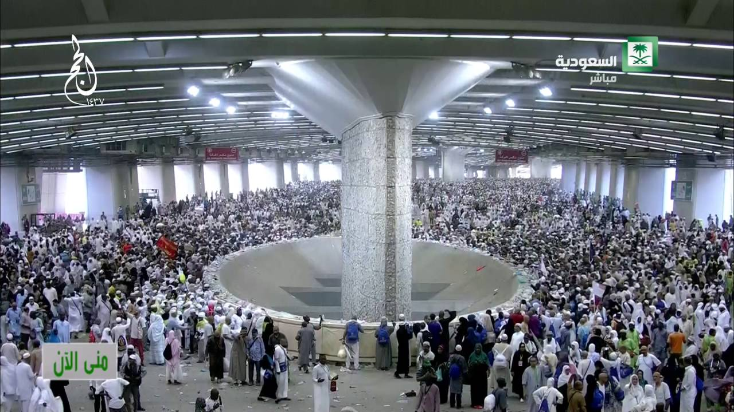
Jamarah

Slide 23
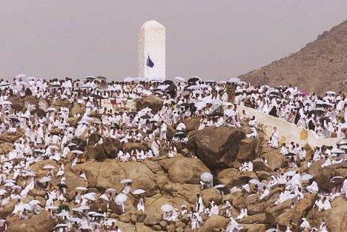
Arafat

Slide 24
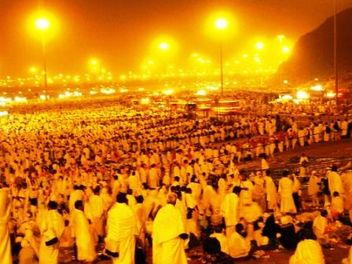
Muzdalifah

Slide 25
Q & A

